Slide 1
For your case study, please start forming up a Google Doc or Google slides to begin to capture all the preliminaries.
- Background material (relevance to security, human rights, etc.)
- Visual (screen image) of KML from Google Earth
- Various visual examples of camps
- Contextual information about visual "features" layout, compactness, tent structure, etc
- Discussion of the two potential questions (classification = detection/awareness ; regression = detection plus group information)
- Focus and drill down on "classification" question for Case Study
- TensorFlow
- more as we progress

Slide 2
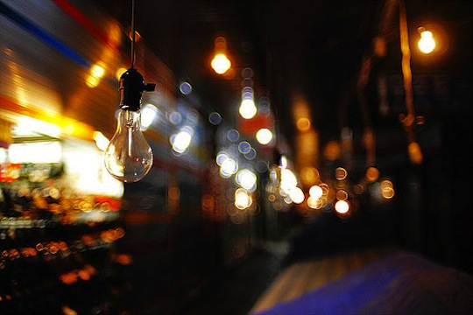
Objective
Use a Neural Network to Detect Refugee Camps and Displaced People using Satellite Images

Slide 3
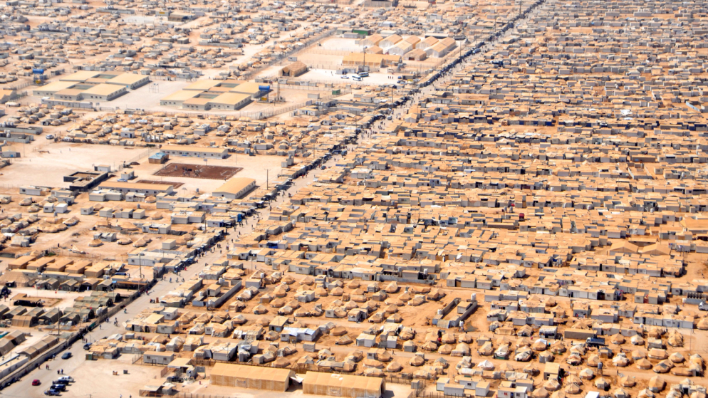
Background
The ongoing civil conflict in Syria has created one of the world’s most serious refugee problems with more than 5 million Syrian refugees displaced in the region and nearly 10 million internally displaced people within Syria.

Slide 4
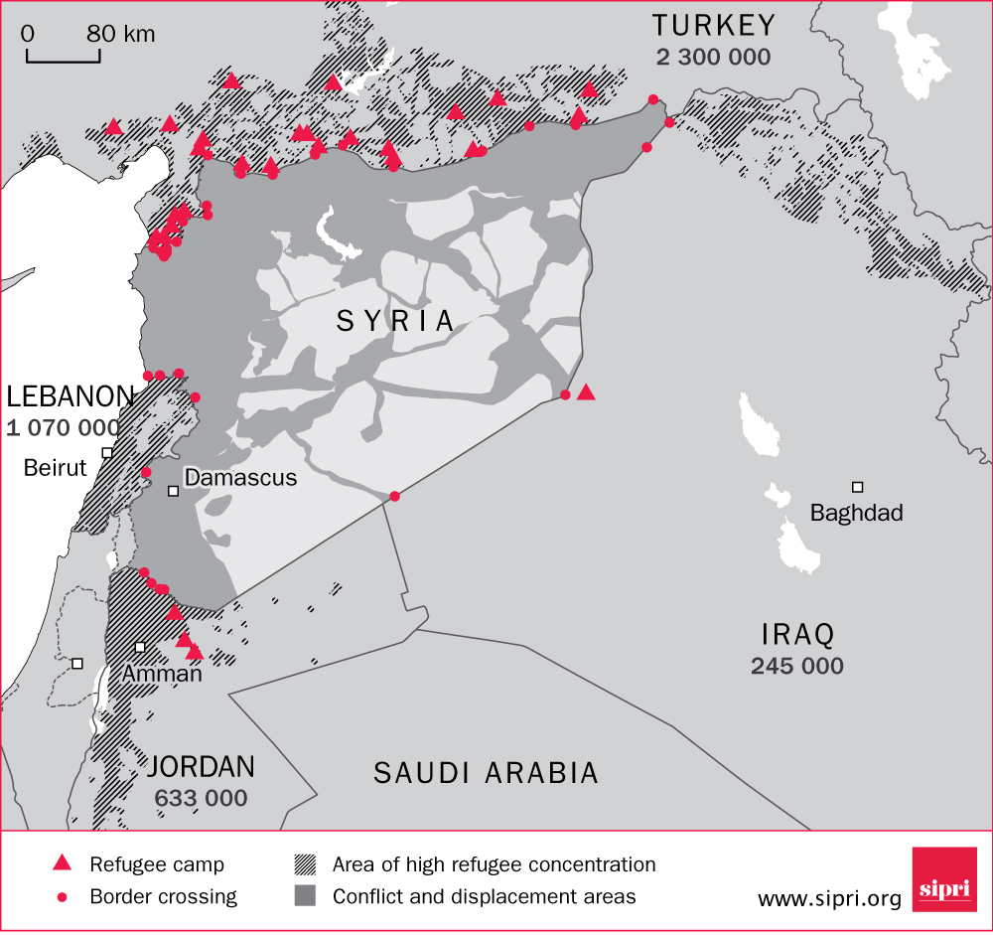
Syrian Refugee Camps
are Largely in
Neighboring Middle
Eastern
Countries
Surrounding Syria

Slide 5
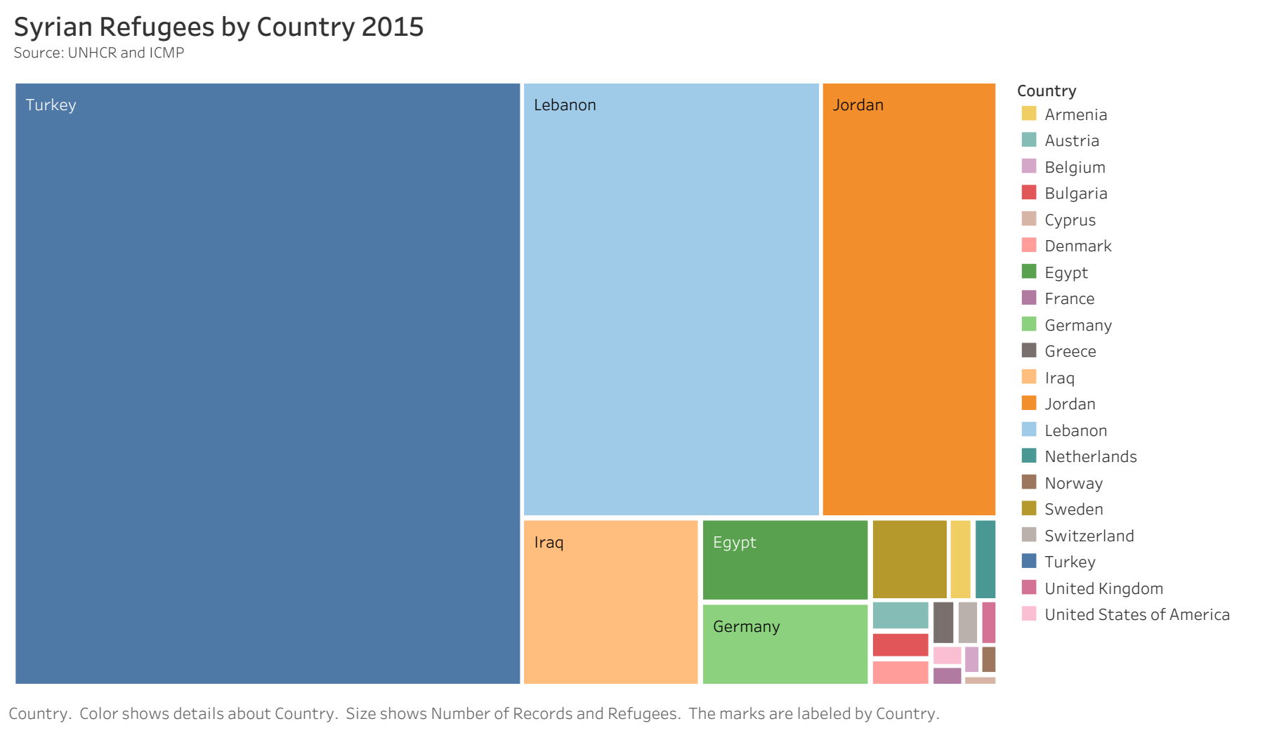

Slide 6
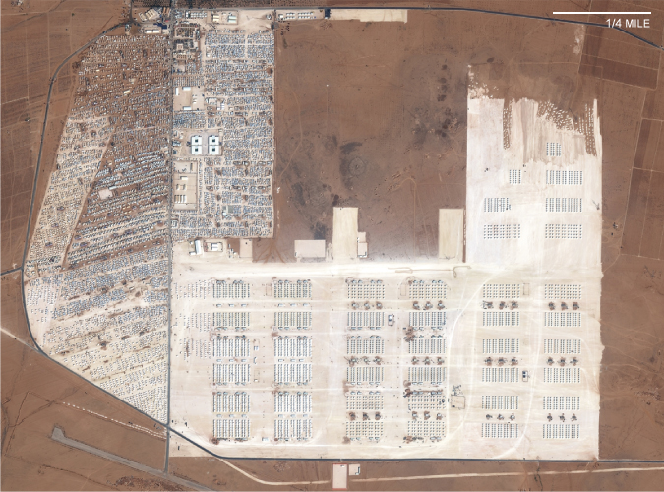
Key Features
Tent Dominated Areas
Clear Borders
White Areas
Outside of Cities or Developed Areas

Slide 7
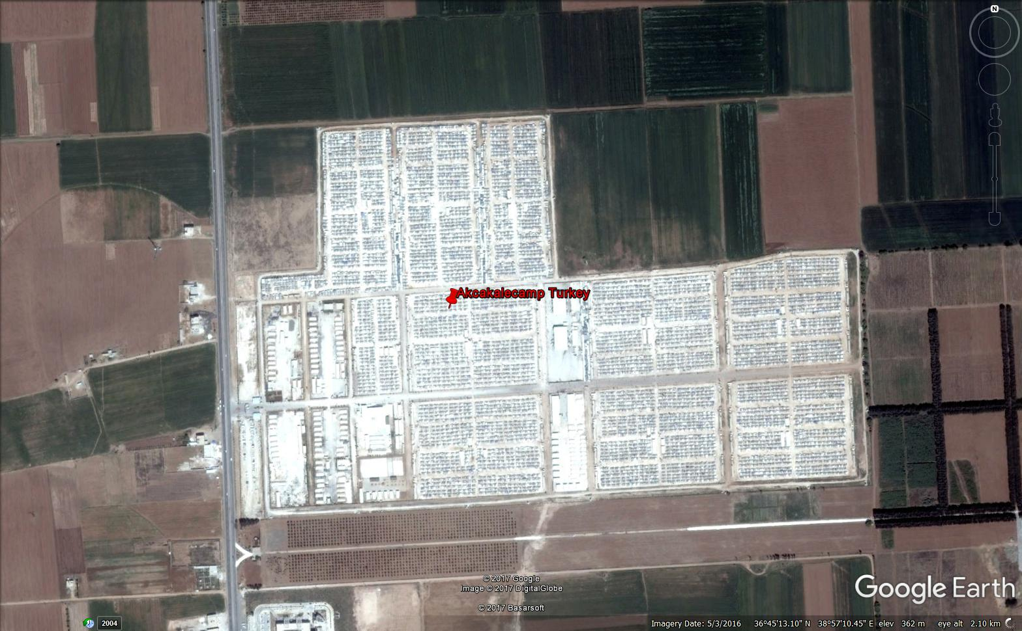
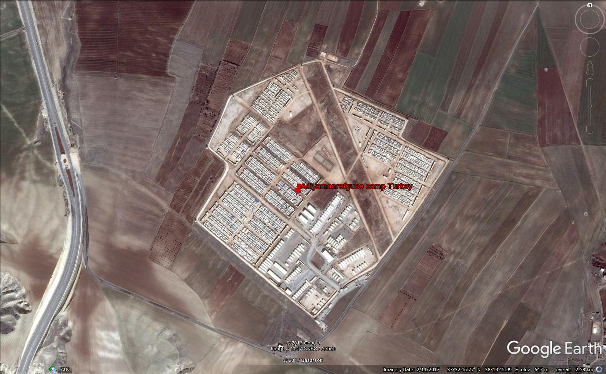
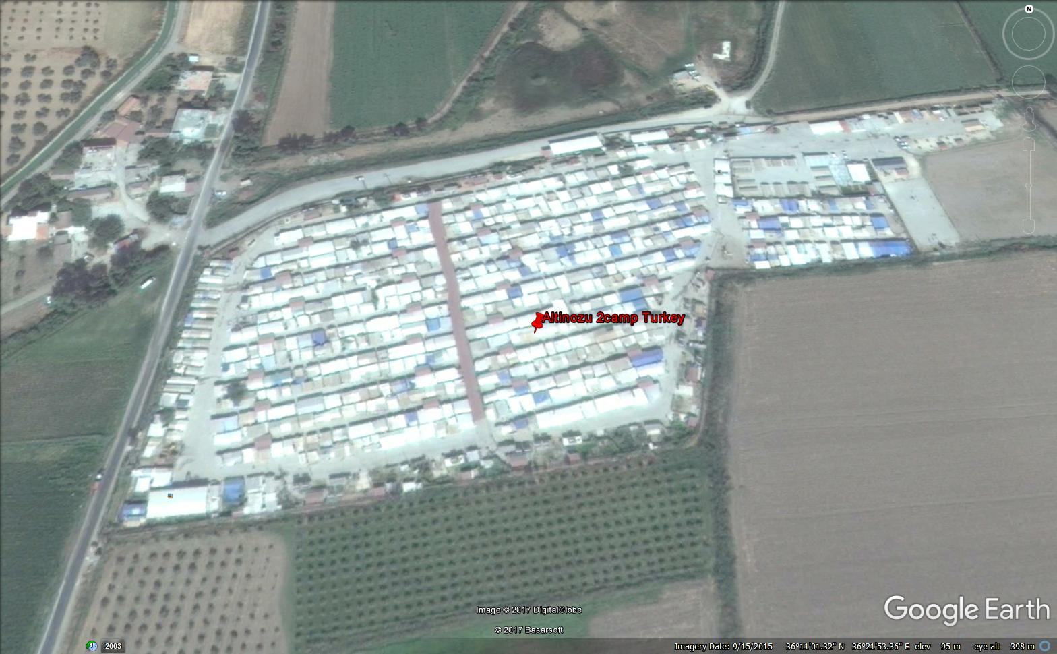
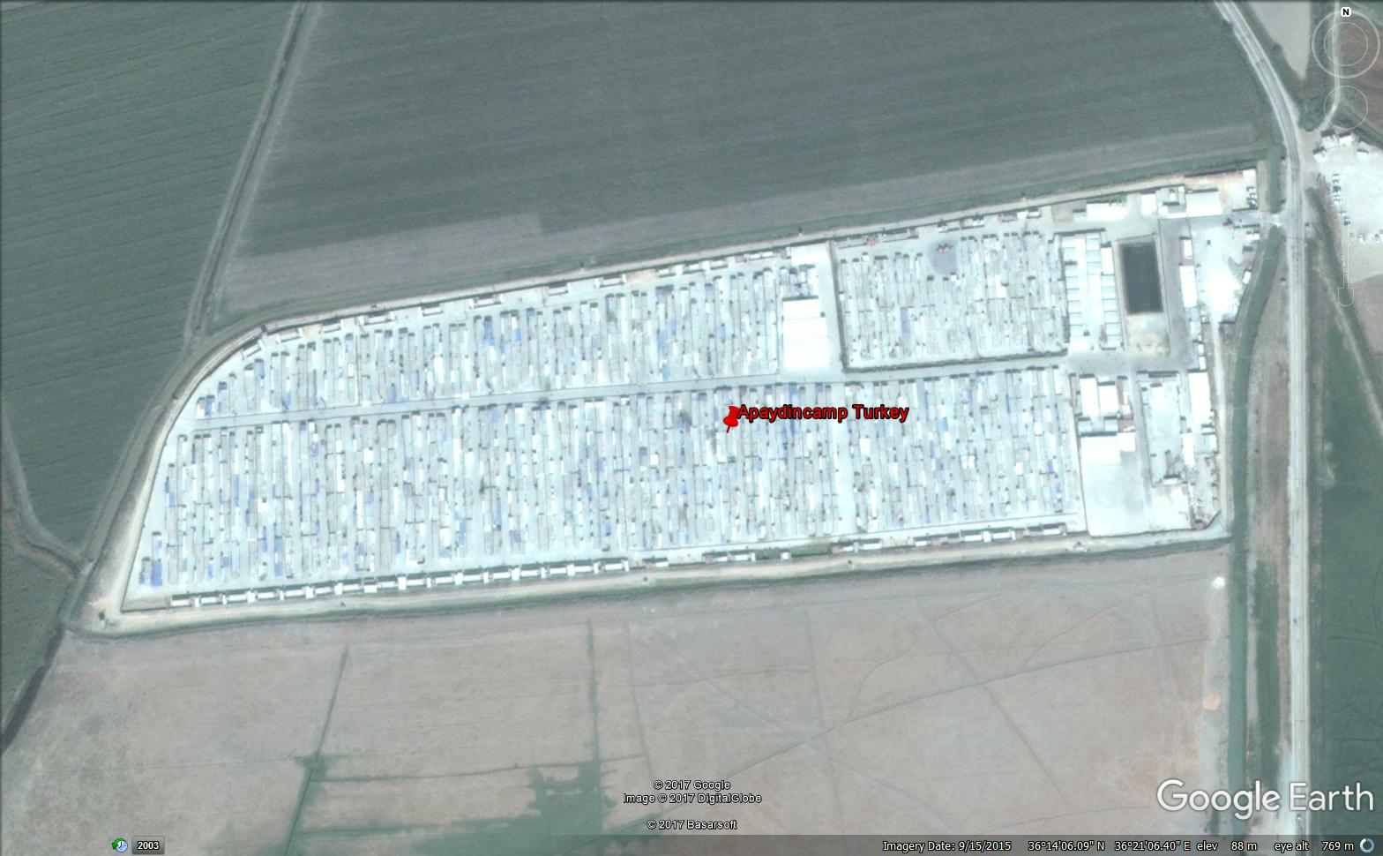
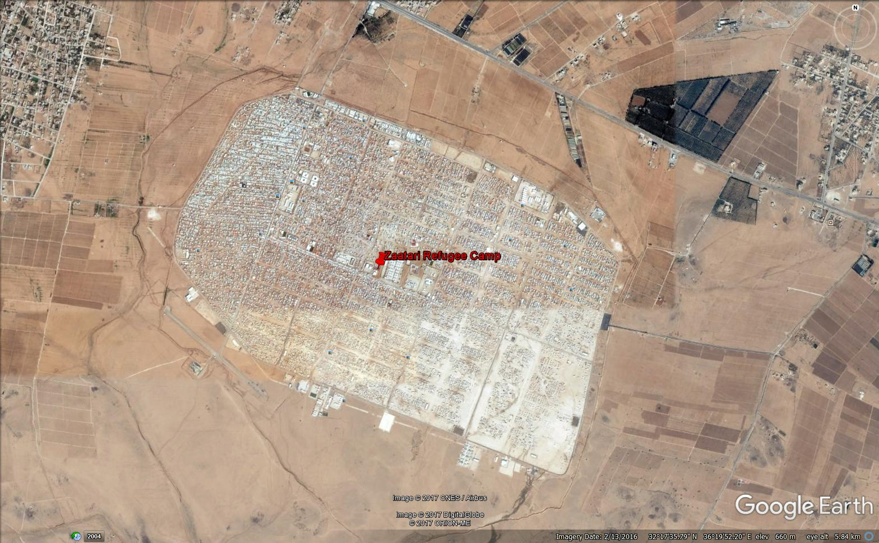
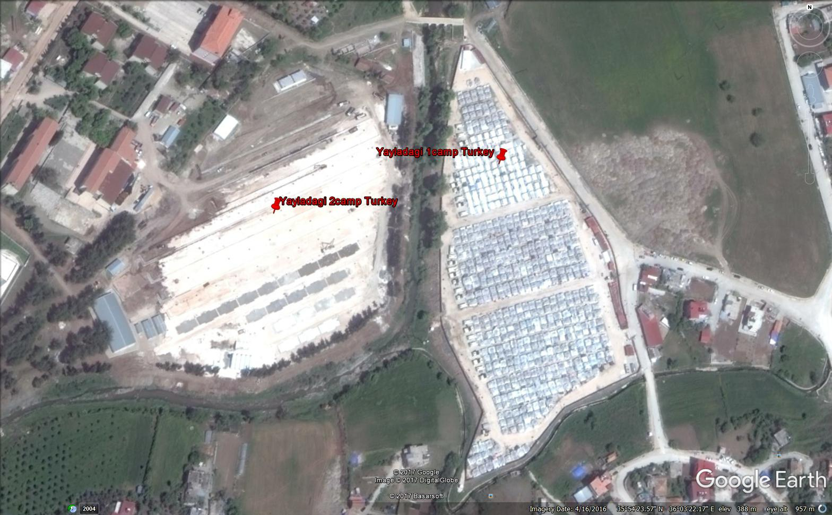
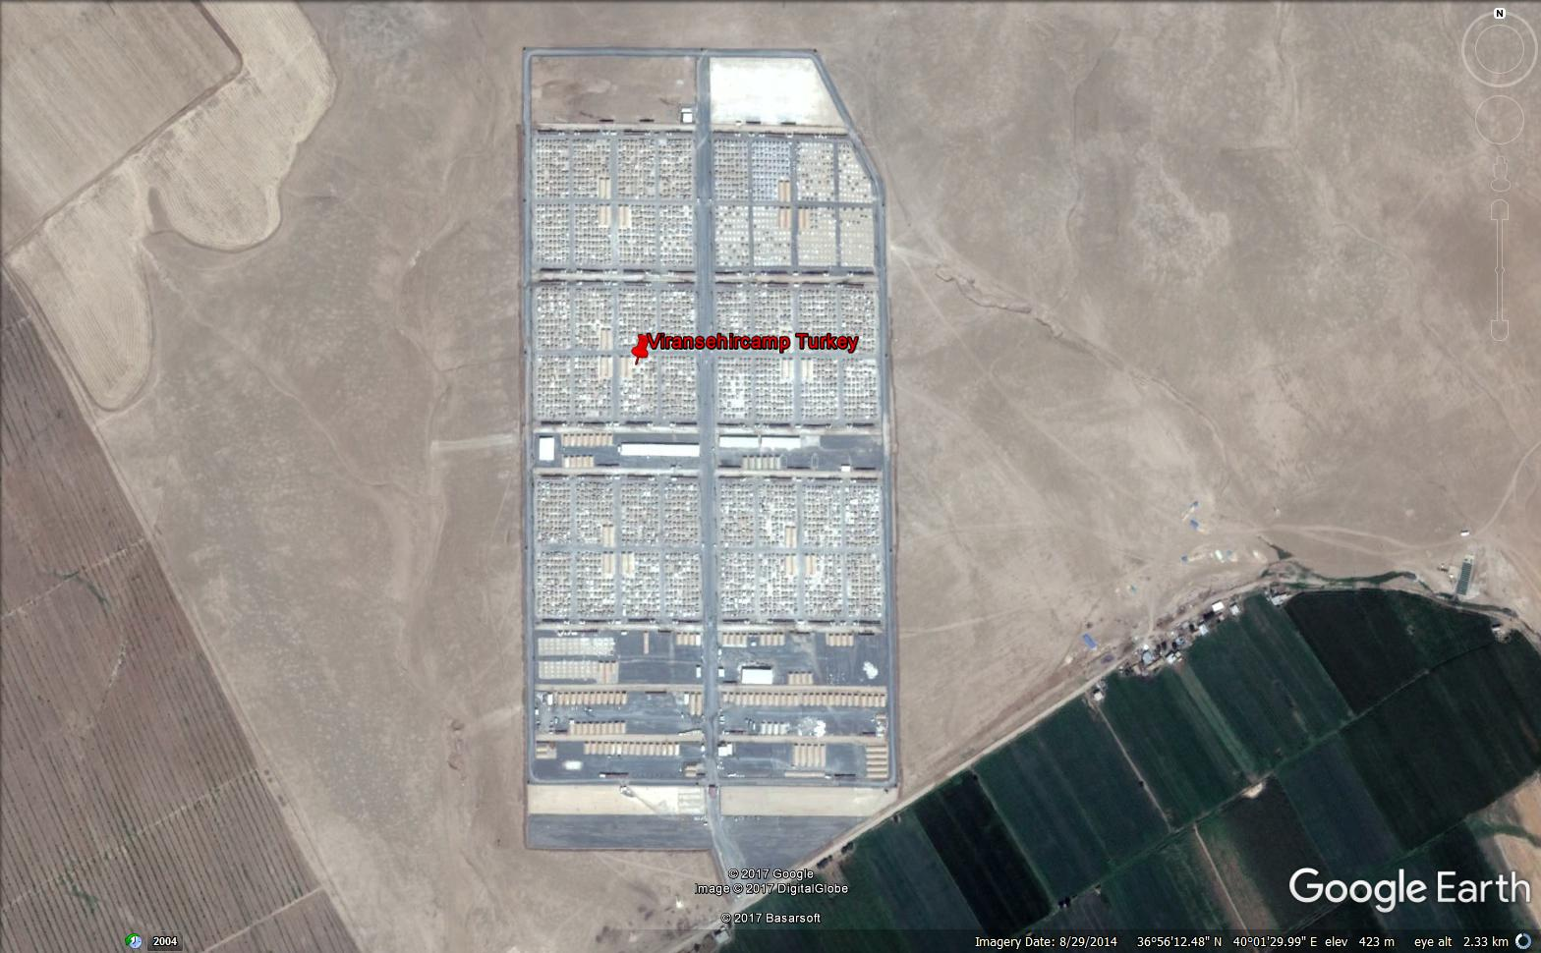
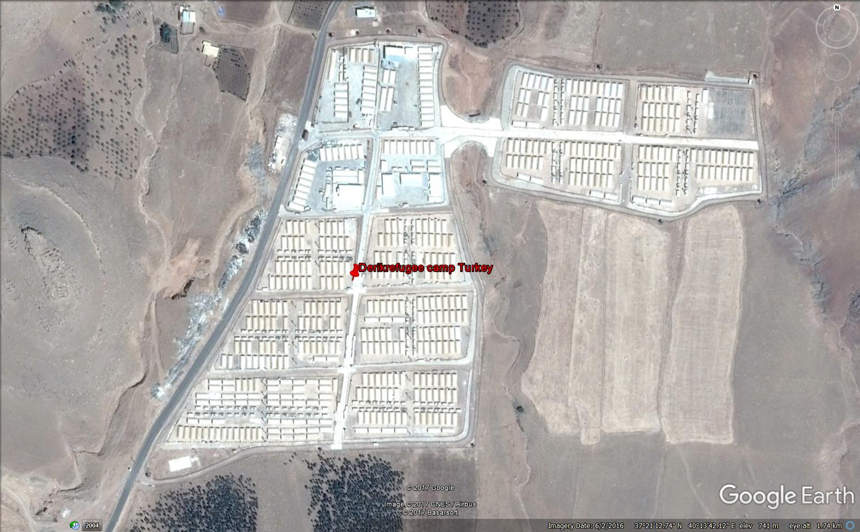
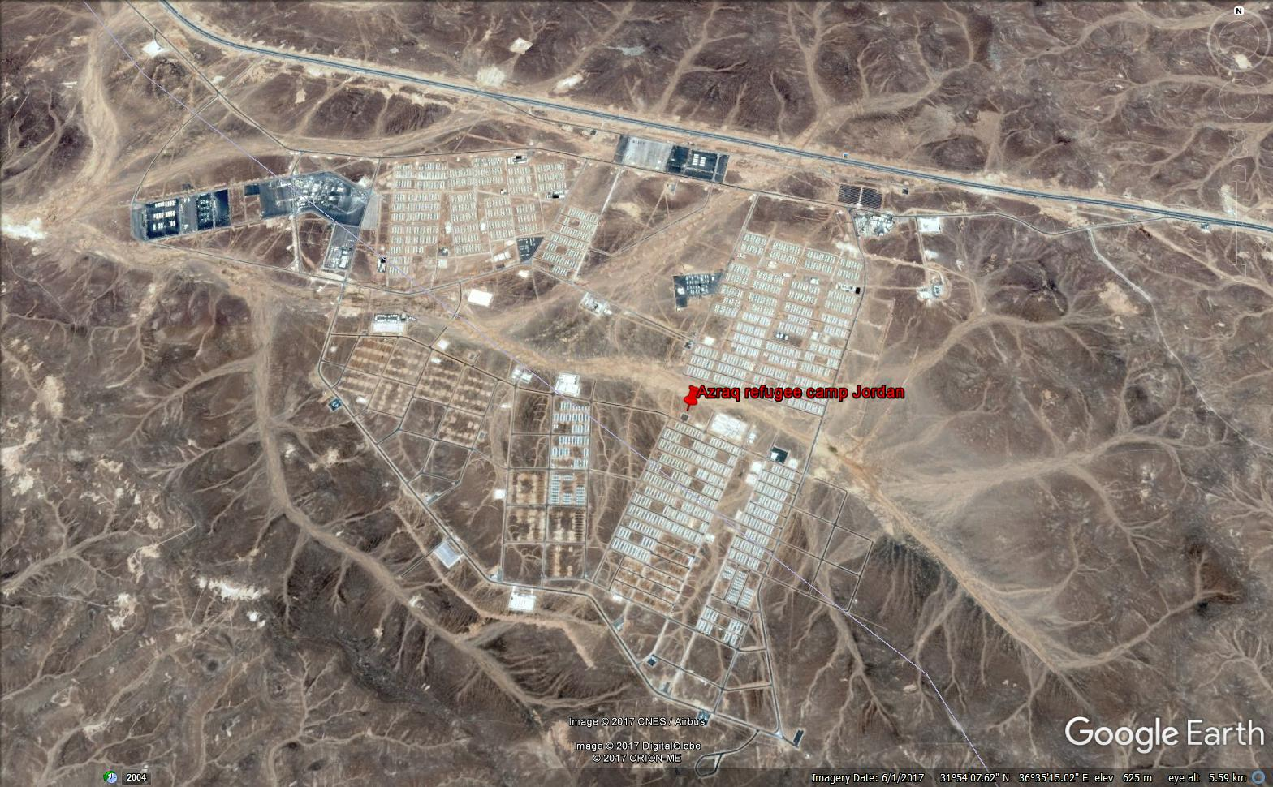
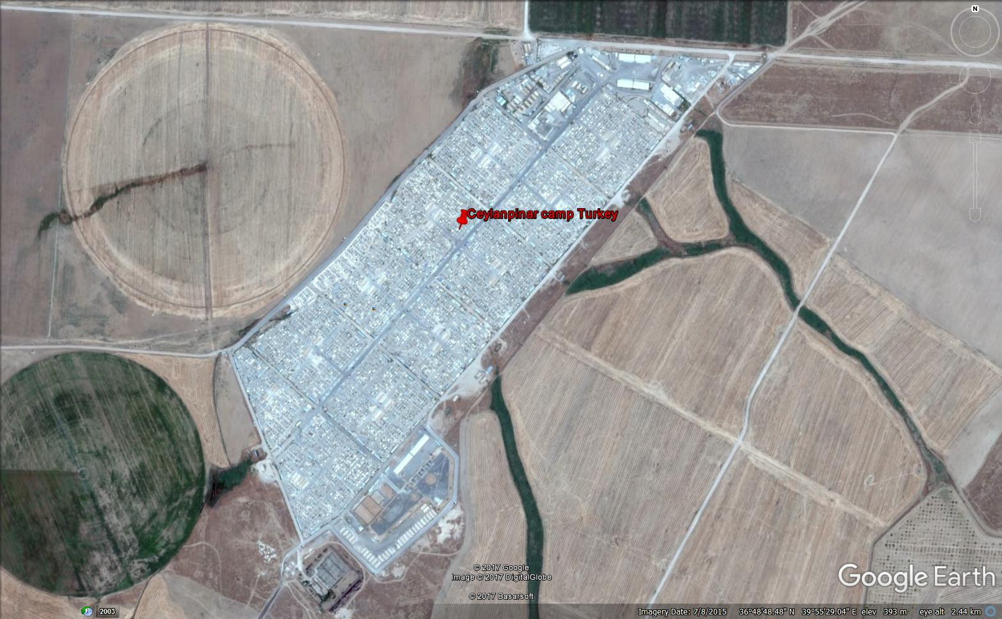
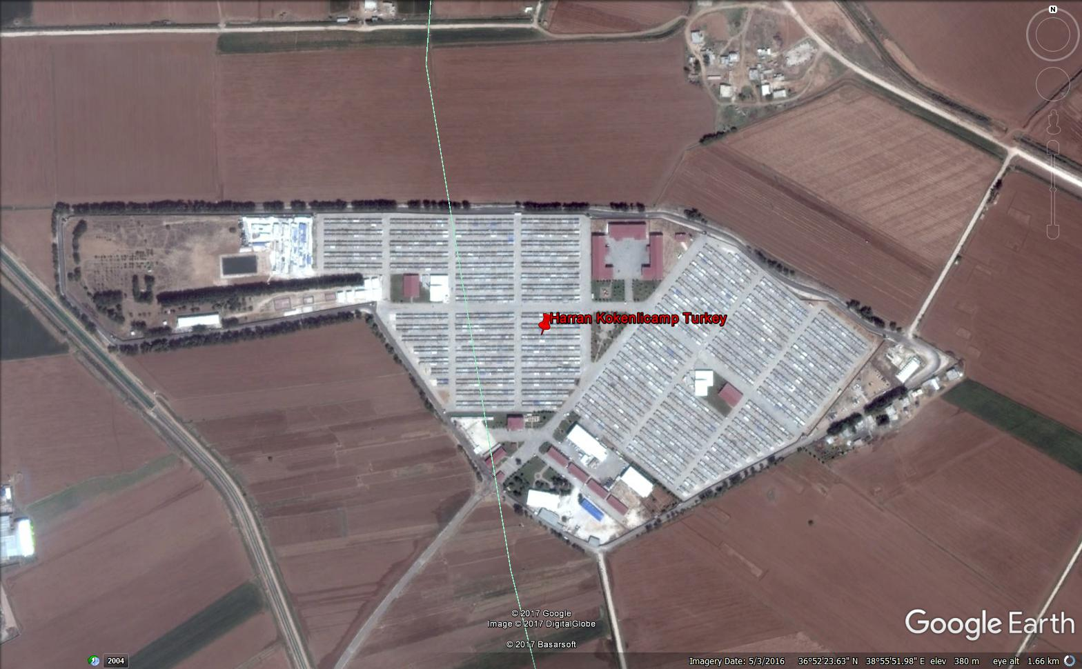
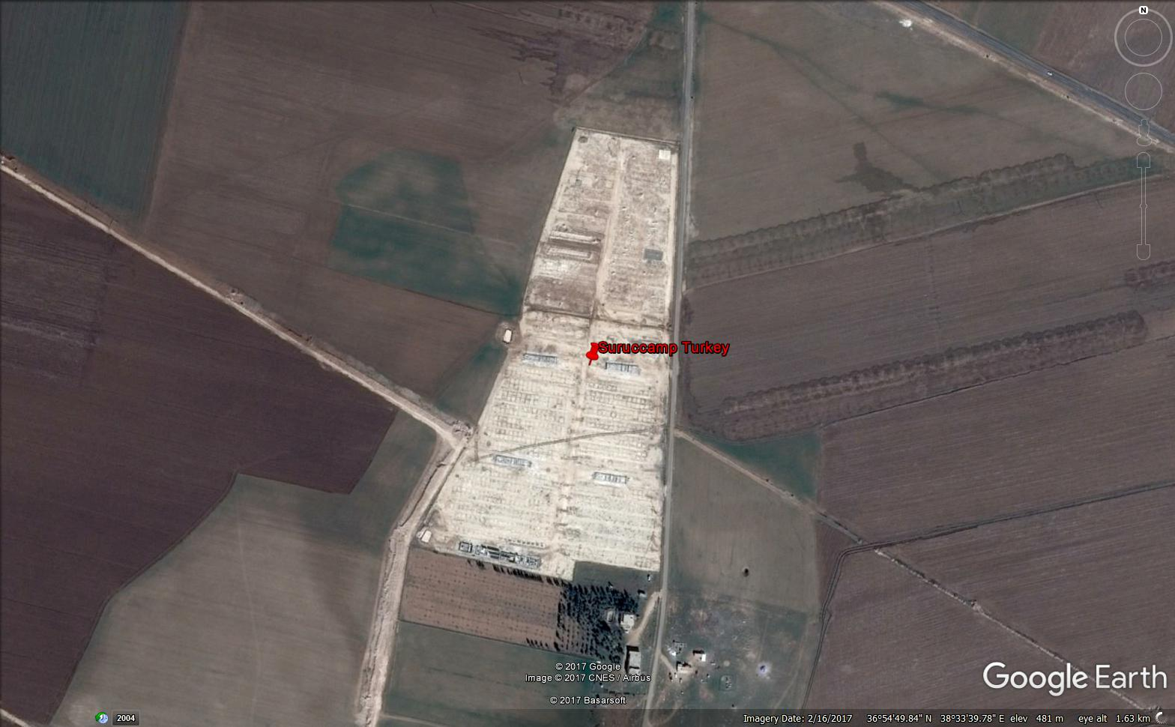
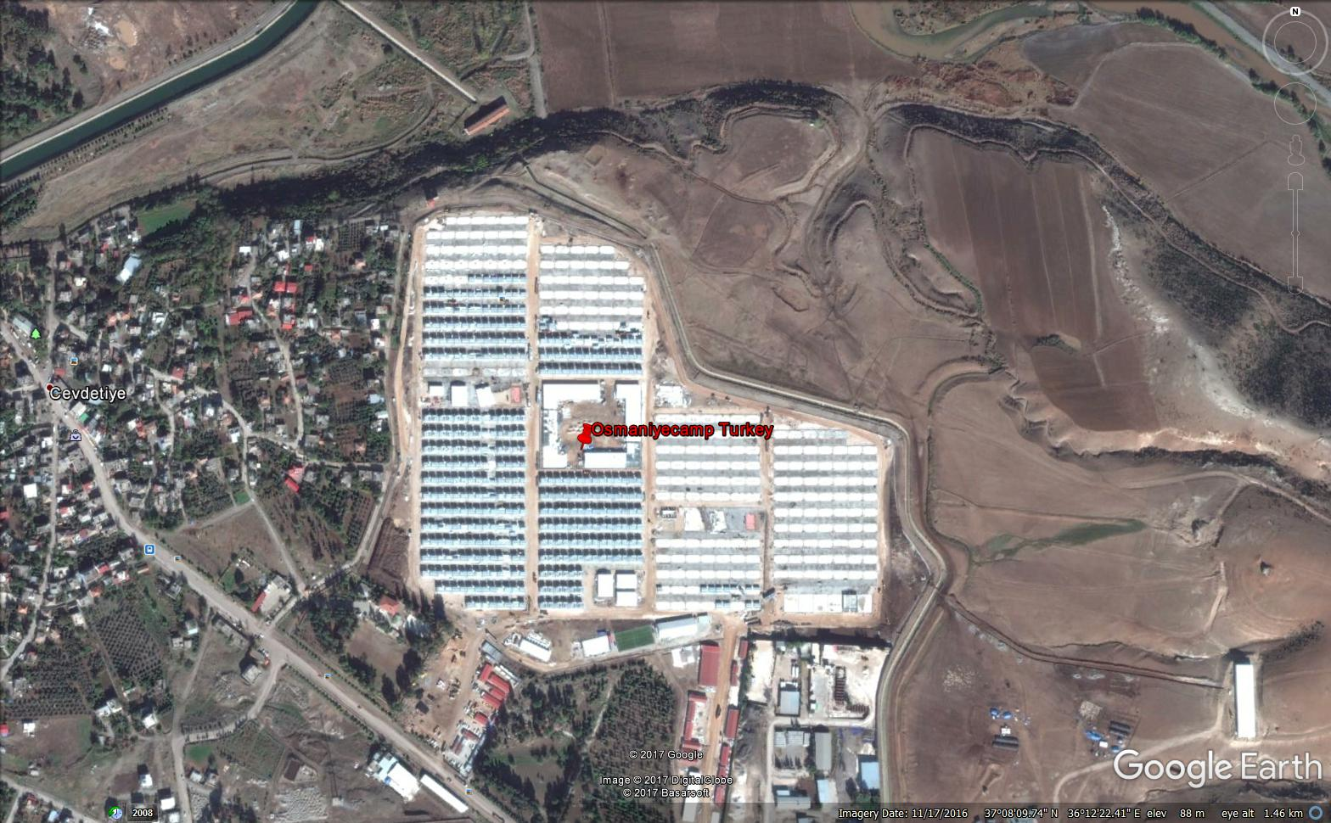
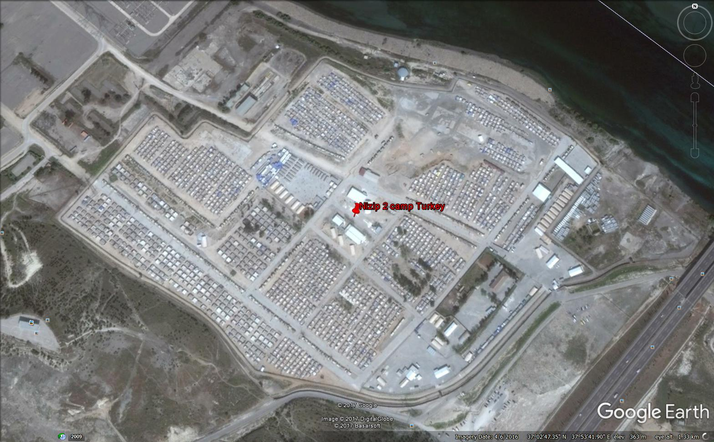
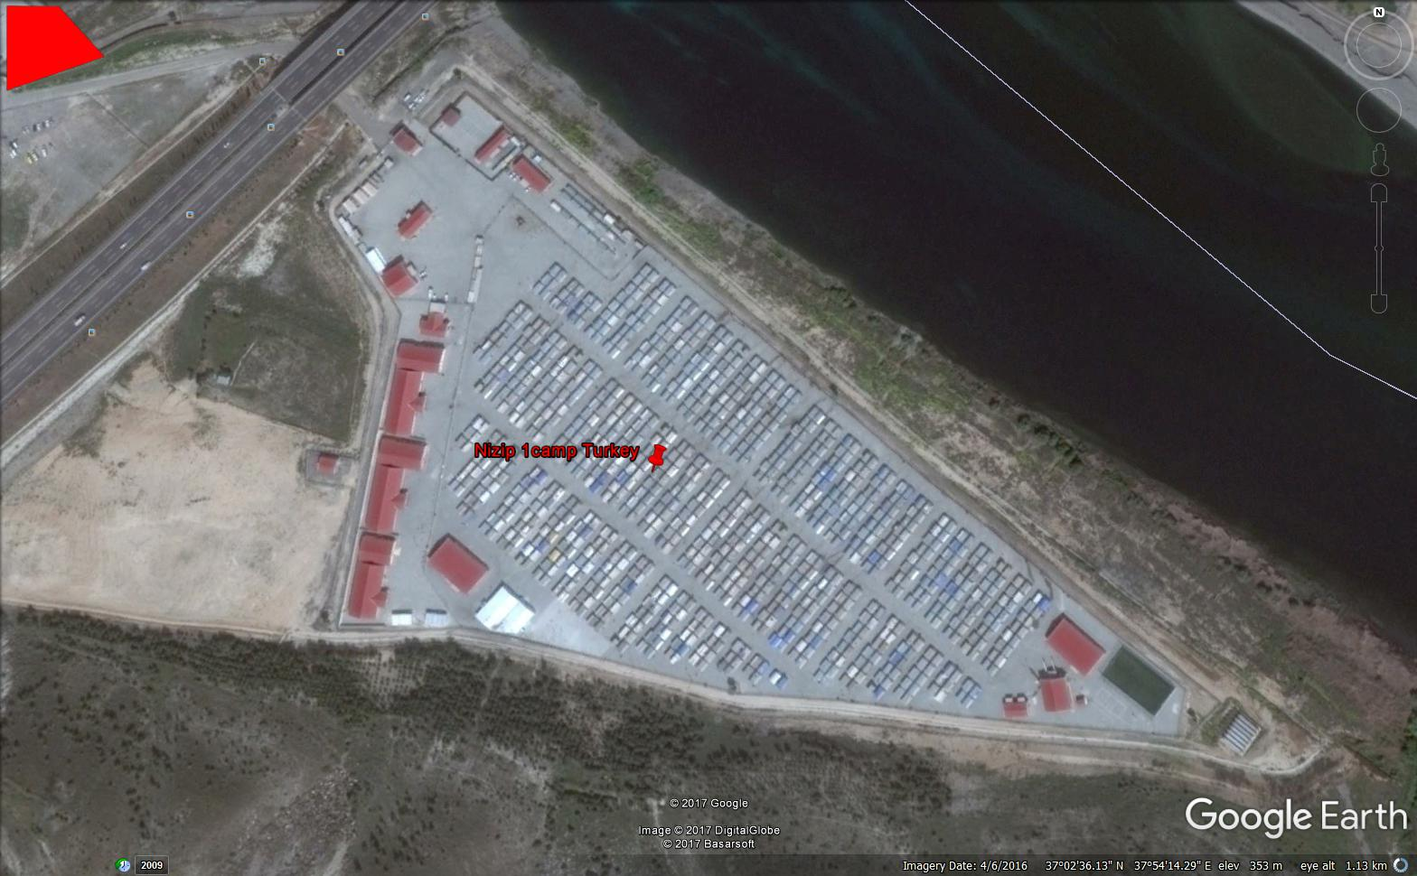
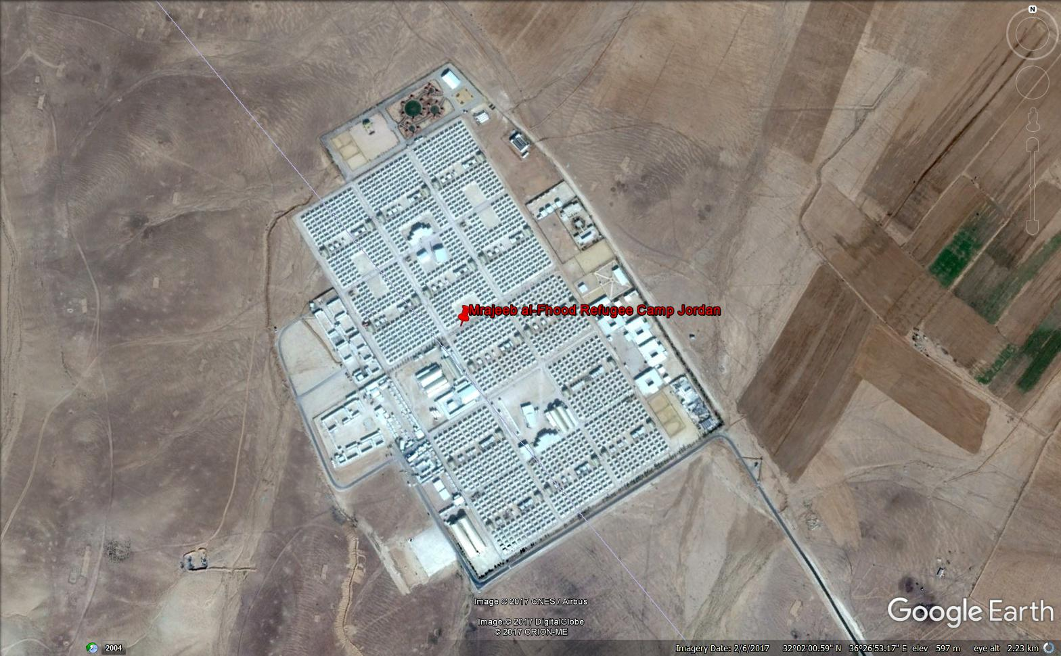
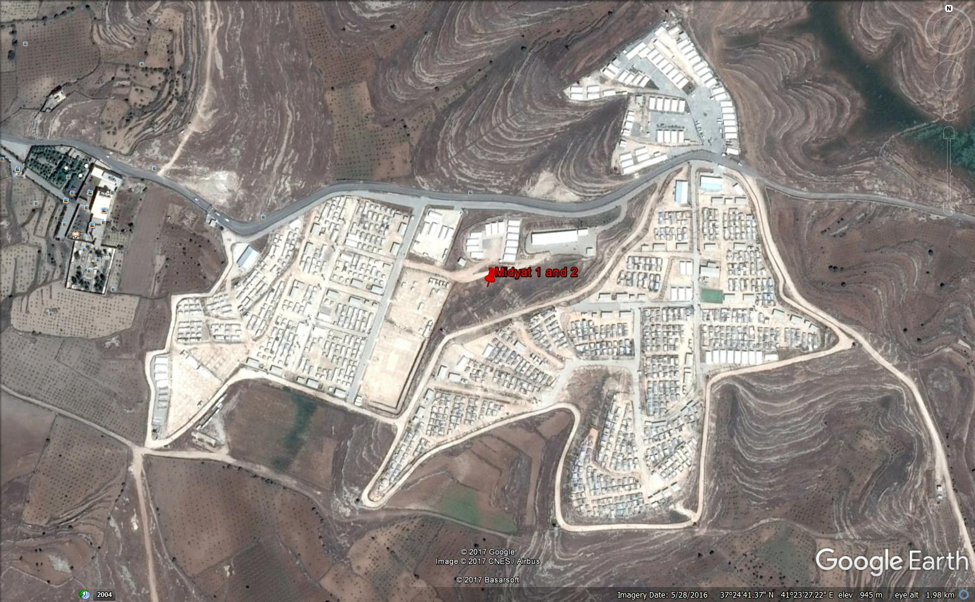
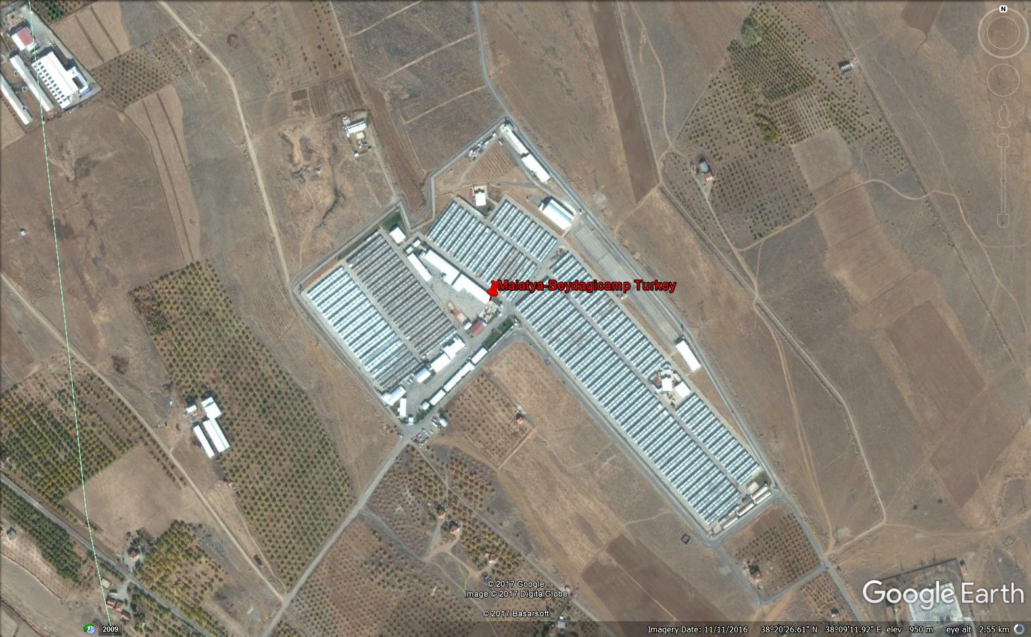
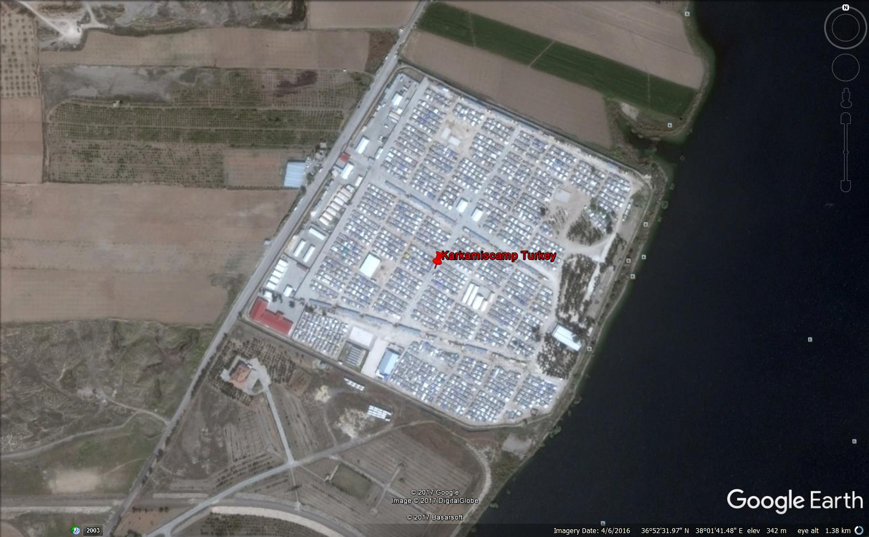
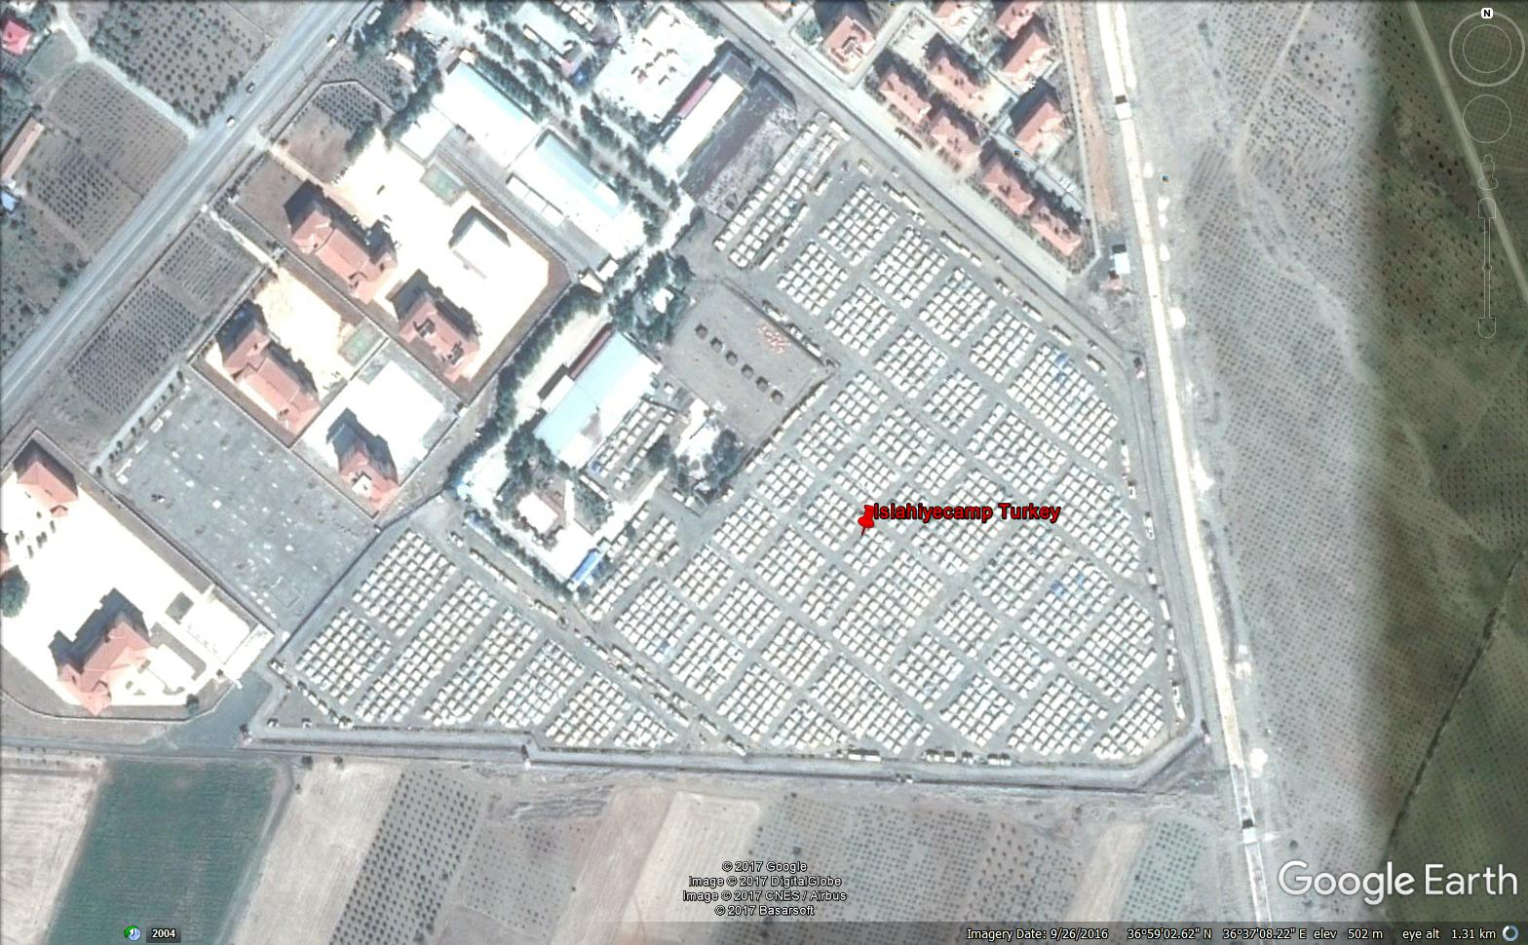

Slide 9



Tools: Neural Network

